Slide 1
Cloud Computing
Mr. R S S RAJU BATTULA
Asst.Prof
Department of CA
Aditya University

Slide 2
Course Contents
UNIT – III
Cloud Platform Architecture: Cloud Computing and service Models, Architectural Design of Compute and Storage Clouds, Public Cloud Platforms, Inter Cloud Resource Management, Cloud Security and Trust Management. Service Oriented Architecture, Message Oriented Middleware.

Slide 3
CLOUD COMPUTING AND SERVICE MODELS
Over the past two decades, the world economy has rapidly moved from manufacturing to more service-oriented.
In 2010, 80 percent of the U.S. economy was driven by the service industry, leaving only 15 percent in manufacturing and 5 percent in agriculture and other areas.
Cloud computing benefits the service industry most and advances business computing with a new paradigm.
In 2009, the global cloud service marketplace reached $17.4 billion.
Users can access and deploy cloud applications from anywhere in the world at very competitive costs.

Slide 4
CLOUD COMPUTING AND SERVICE MODELS
The concept of cloud computing has evolved from cluster, grid, and utility computing.
Cluster and grid computing use computers in parallel to solve problems of any size.
Utility and Software as a Service (SaaS) provide computing resources as a service with the notion of pay per use.
Cloud computing is a high-throughput computing (HTC) paradigm whereby the infrastructure provides the services through a large data center or server farms.
The cloud computing model enables users to share access to resources from anywhere at any time through their connected devices.

Slide 5
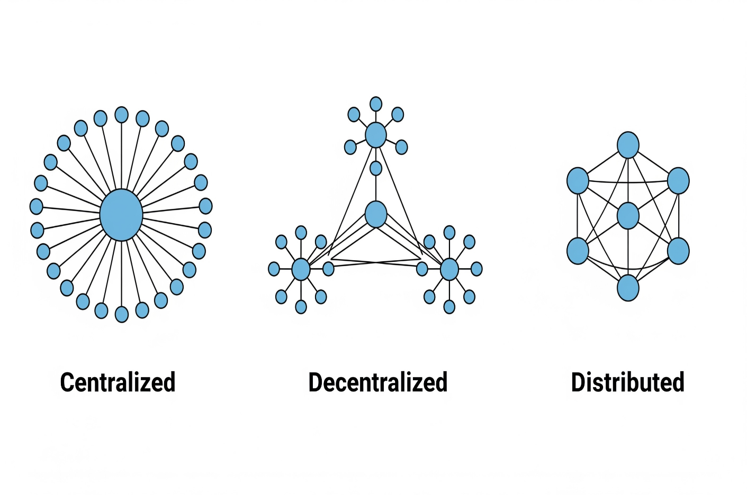
Centralized versus Distributed Computing Centralized
Centralized
Contains single points of failure by design
Contains bottlenecks by design
Limited scalability
Controlled by a single entity
Hackers dream
Infrastructure hungry
Distributed
No single point of failure by design
No bottlenecks by design
Difficult to attack or censor
Information leaks are less likely and much smaller in scale

Slide 6
Feature | Public Cloud | Private Cloud | Hybrid Cloud
Ownership | Owned & managed by third-party providers | Owned & managed by a single organization | Combination of public & private cloud
Access | Anyone can use on subscription/pay-per-use basis | Restricted to one organization | Mix of public + private access
Cost | Low upfront cost, pay-per-use | High initial setup & maintenance cost | Balanced cost (depends on usage)
Scalability | Highly scalable (virtually unlimited) | Limited to organization’s infrastructure | Flexible, scalable as needed
Security | Moderate (shared infrastructure, depends on provider) | High (dedicated resources & full control) | Medium-High (sensitive data on private, other workloads on public)
Control | Minimal control (provider manages) | Full control (organization manages) | Partial control (mix of both)
Performance | Good, but may vary (shared resources) | High & consistent (dedicated resources) | Balanced (critical tasks on private, scalable tasks on public)
Examples | AWS, Microsoft Azure, Google Cloud | VMware vSphere, OpenStack, Microsoft Azure Stack | Azure Hybrid, AWS Outposts, IBM Hybrid Cloud

Slide 7
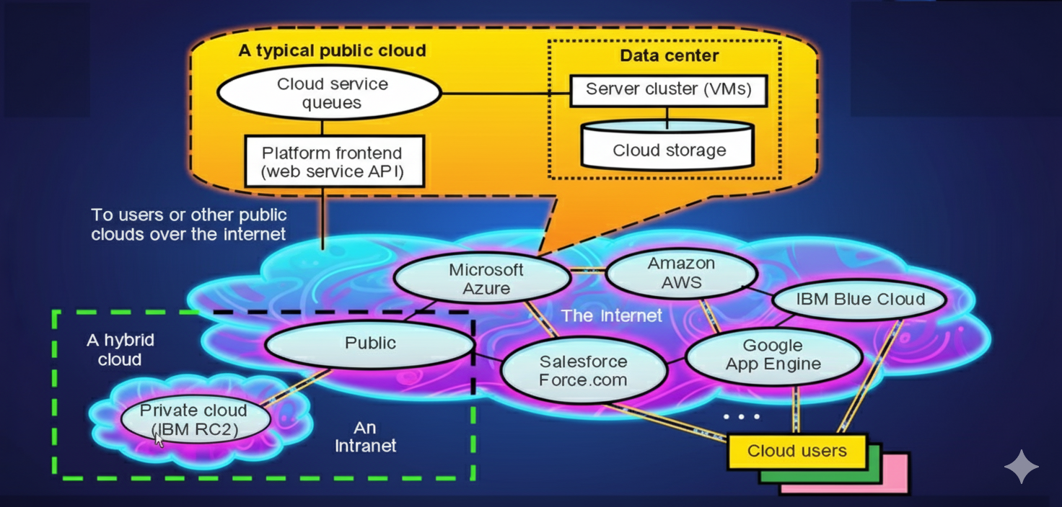
A functional Architecture of Public ,Private and Hybrid Clouds and Connectivity of Representative Clouds

Slide 8
Architectural Design of Compute and Storage Clouds
A Generic Cloud Architecture Design
Layered Cloud Architectural Development
Virtualization Support and Disaster Recovery
Architectural Design Challenges.

Slide 9
Cloud Platform Design Goals
Four major design goals of a cloud computing platform.
Scalability
Virtualization
Efficiency
Reliability
1. Scalability: The system's ability to handle an increasing amount of work or a growing number of users. The text notes that this can be achieved through a cluster architecture, which makes it simple to add more servers and bandwidth as needed.

Slide 10
Virtualization: A technology that allows a single physical server to be partitioned into multiple virtual environments, each acting as an independent machine. This enables efficient use of hardware resources.
Efficiency: This goal refers to optimizing resource utilization, reducing costs, and improving performance. It often involves a "pay-as-you-go" model where you only pay for the resources you use.
Reliability: The ability of the cloud system to consistently perform and deliver services as expected, without interruptions or failures. Key components of reliability include data durability, fault tolerance, and a system's ability to recover automatically from failure.

Slide 11
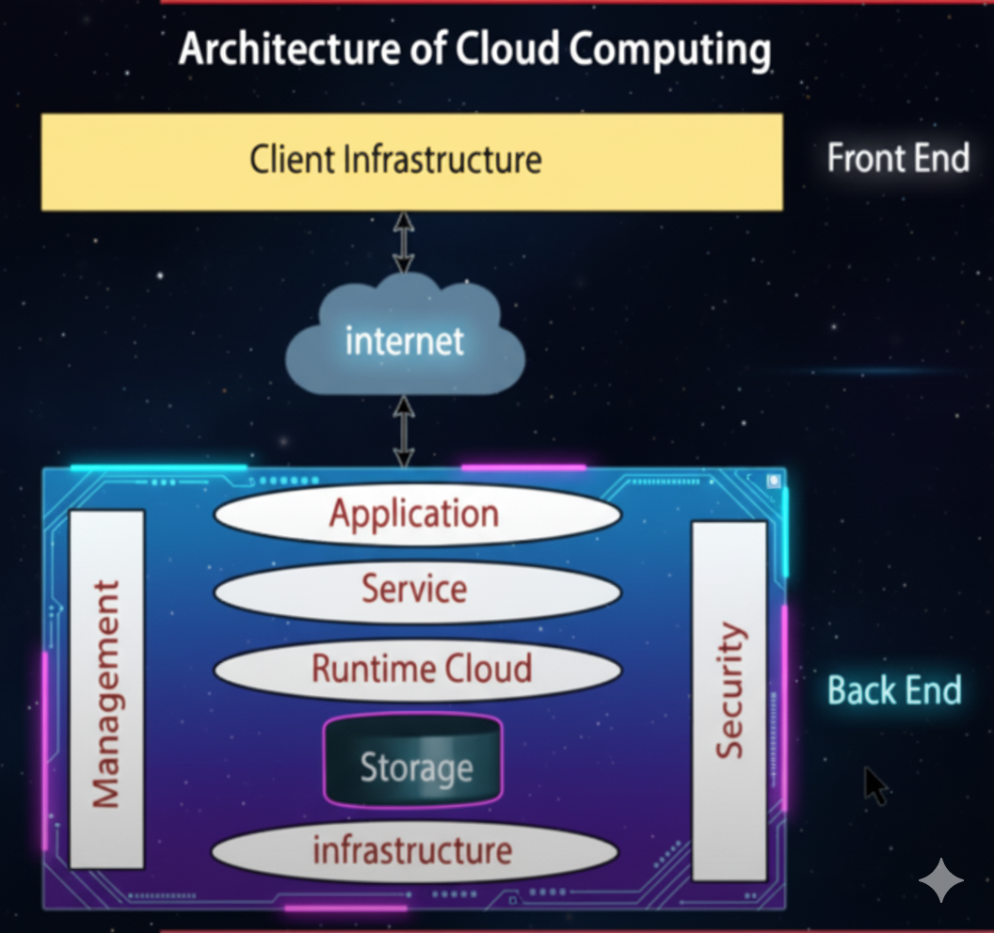
Generic Cloud Architecture
The Internet Cloud: This is described as a "massive cluster of servers."
Resource Allocation: Resources (space, data, and speed) are allocated per demand dynamically.
Cloud Types:
Private clouds are easier to manage.
Public clouds are easier to access.
Trends:
The trend in cloud development is that more and more clouds will be hybrid. This is because many cloud applications need to go beyond the boundary of an intranet.
Security: Security is a critical issue in safeguarding the operation of all cloud types.
Interaction: One must learn how to create a private cloud and how to interact with public clouds in the open Internet.

Slide 12
CLOUD ARCHITECTURE IN LAYERS
The architecture of a cloud is developed at three layers:
Infrastructure
Platform
Application/Software
These three development layers are implemented with virtualization and standardization of hardware and software resources provisioned in the cloud.
This infrastructure layer serves as the foundation for building the platform layer of the cloud for supporting PaaS services.
The platform layer is a foundation for implementing the application layer for SaaS applications.

Slide 13
Cloud Architecture in Layers
The infrastructure layer is built with virtualized compute, storage, and network resources. Proper utilization of these resources provides the flexibility demanded by the users.
The platform layer environment is provided for the development, testing, deployment and monitoring the usage of apps. Indirectly, a virtualized cloud platform acts as a 'system middleware' between the infrastructure and application layers of a cloud.
The application layer is formed with the collection of different modules of all software that are needed for the SaaS apps. The general service apps include those of information retrieval, doc processing, and authentication services. This layer also used in large-scale by the CRMs, financial applications, and supply chain management.

Slide 14
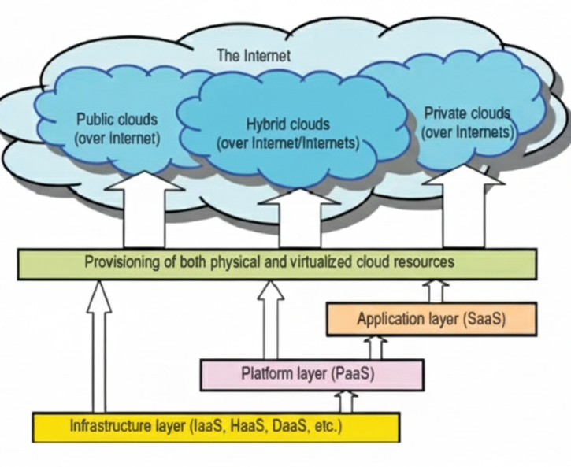

Slide 15
Layered Architectural Development of Cloud Platform
A diagram illustrating the layered architecture, showing:
The Internet
Public clouds (over internet)
Hybrid clouds (over Internet/Internets)
Private clouds (over Internets)
Provisioning of both physical and virtualized cloud resources
Application layer (SaaS)
Platform layer (PaaS)
Infrastructure layer (IaaS, HaaS, DaaS, etc.)
Textual descriptions of the layers:
The infrastructure layer is built with virtualized compute, storage, and network resources.
The platform layer provides users with an environment to develop their applications, to test, deploy and monitor execution results and performance.
The application layer is formed with a collection of all needed software modules for SaaS applications.

